Slide 1
CSC 431: Cyber Security Operations Week 2
Frank M. Olmstead
Frank.Olmstead@lsus.edu
Notes:
CSC 431: Cyber Security Operations 3 cr.
Prerequisite: CSC 382. Introduce the fundamental cyber security operations to secure systems through monitoring, detecting, investigating, analyzing, and responding to security events. Secure systems from cyber security risks, threats, and vulnerabilities. Prepare students for additional certifications beyond the CCNA. Three hours of combined lecture and lab in a computer lab setting.

Slide 2
Agenda – 2nd Meeting
Frank Olmstead
Recap of 1st Meeting
Types of reporting
I&W
AS&W
Level of Reporting
Operational
Tactical
Strategic
Malware Analysis
Types
Process (Overview)
Developing Rules
A day in the life – BEC Example

Slide 3
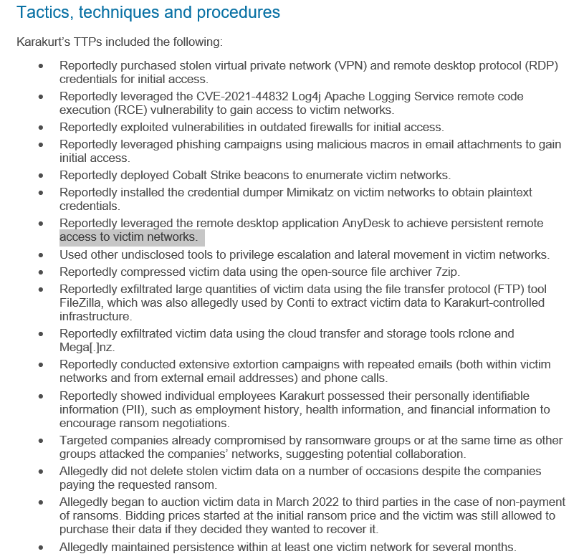
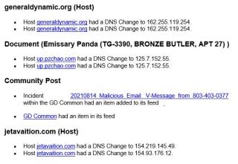
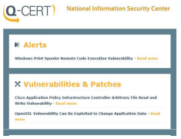
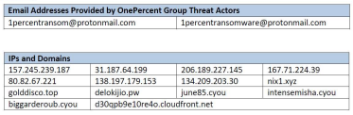
Types of Reporting
Frank Olmstead
Attack Sensing & Warning (AS&W)
Sense changes in owner's environment (e.g., vulnerabilities)
Vulnerability alerts
Antivirus alerts for new worms, Trojans, malware, etc
Suspicions e-mails (sources, content, attachments)
Hostile IPs and domains
Indicators & Warning (I&W)
Sense changes in threat tactics

Slide 4
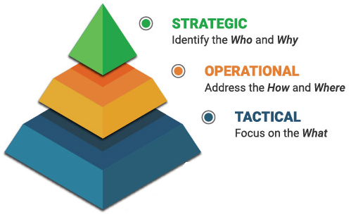
Levels of Reporting
Frank Olmstead
Strategic
Identifies the who and why to provide organizations with crucial insight
Operational
Observed threat actor Tactics, Techniques, and Procedures (TTP)
Tactical
Indicators of Compromise (IOC) such as file names, file hashes, domain names, IP addresses
Notes:
Strategic Cyber Threat Intelligence
CTI at the strategic level identifies the who and why to provide organizations with crucial insight. It aims to identify who is behind a specific threat/family of threats, while addressing ongoing trends. CTI at the strategic level is also about the why. Why is an organization an organization being targeted? Why is a specific malicious cyber actor (MCA) or group of MCAs interested in an organization or industry vertical — for example, healthcare? In many cases, strategic level CTI can be tied to Advanced Persistent Threats (APT) activities although not always.
Operational Cyber Threat Intelligence
CTI at the operational level addresses the how and where. The observed threat actor Tactics, Techniques, and Procedures (TTP) define the how of CTI. The how goes beyond just an alert, or series of alerts. The how assists organizations to understand the extent of a breach, or prepare defense in advance. The where of CTI helps organizations conduct threat hunts proactively, in advance of a compromise, or after an incident when recovery has begun. In general terms, you cannot catch the MCAs in an environment unless you know where to look.
Tactical Cyber Threat Intelligence
CTI at the tactical level focuses on the what. Indicators of Compromise (IOC) such as file names, file hashes, domain names, IP addresses, and much more, define the what of CTI. IOCs can be used to triage and validate alerts, support rules for firewalls or intrusion detection/prevention systems, endpoint detection & response systems, and other similar capabilities. The what takes the form of internally generated data which resides in Security Operations Centers (SOC) and, more often than not, is organized into multiple trusted feeds that are hopefully tuned to the organization’s environment.
https://zvelo.com/strategic-operational-tactical-cyber-threat-intelligence/

Slide 5


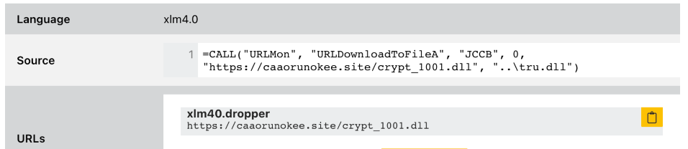
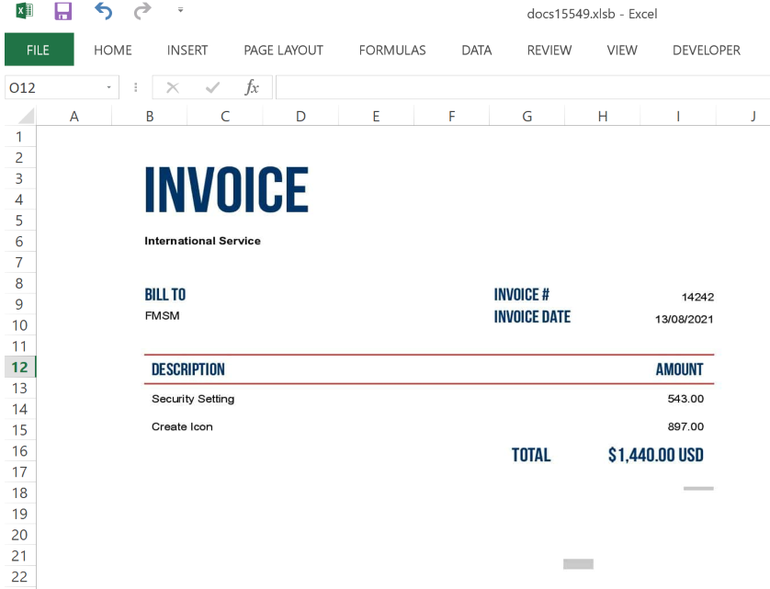
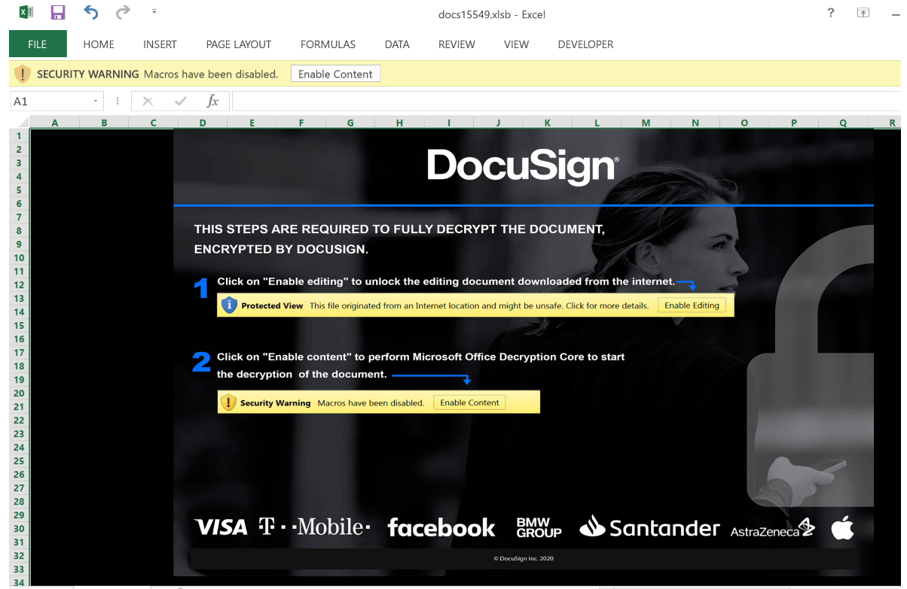
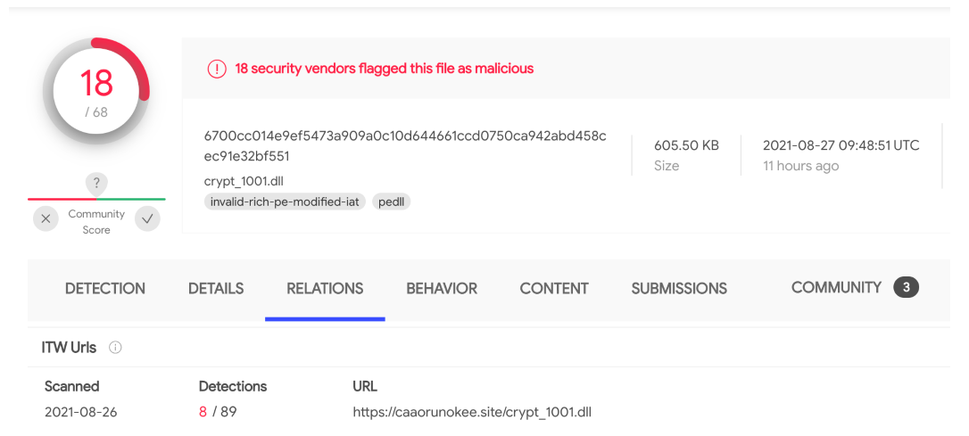
Malware Analysis
Frank Olmstead
Types
Code Review
Dynamic
Static
Surface

Slide 6
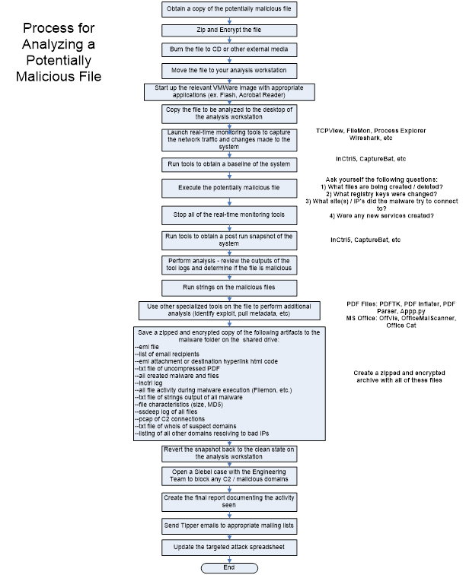
Frank Olmstead
Malware Analysis
The analyst should ask the following questions to determine if the file or site involved in the incident is malicious:
What files were created/modified/deleted on the workstation when the malware was run?
Were any registry keys added/deleted/removed when the malware was run?
What network traffic was generated upon executing the malware? (IPs, Ports, Protocols used)
Was the file packed? If so, which packer was used?
What communication channel is being used?
What vulnerability is being exploited?
What mitigation techniques could be used to prevent this attack?
Is there a patch that could be installed?
Does AV detect this threat?
Are there any tools that could block the activity ?
Can the C2 domain or the IP be blackholed or blocked?
Can a vulnerable function be disabled within the vulnerable application or OS?
Can HBSS signatures be written to detect this threat?
What is the intent of the adversary?
How sophisticated is the attack?

Slide 7
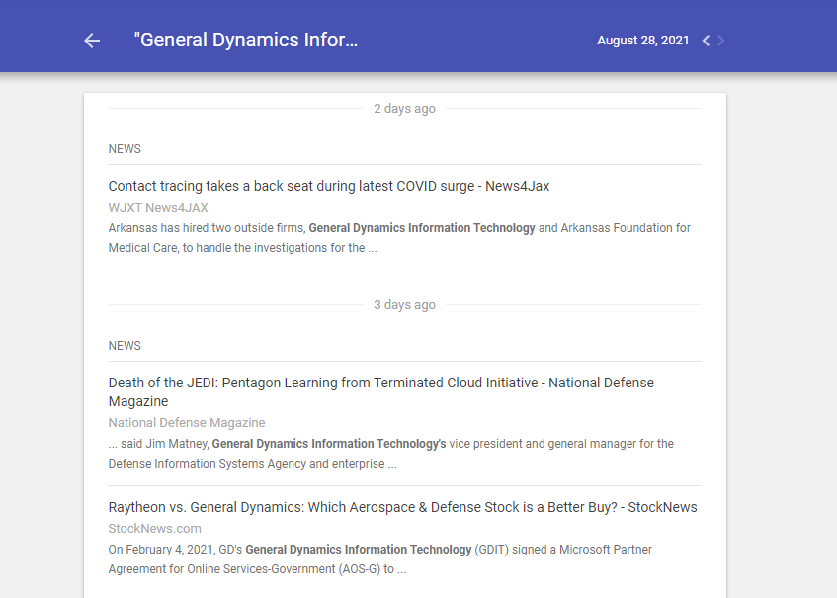
Creating simplistic rules
Frank Olmstead
Types
Host
Yara
Network
Snort
Uses
Detection
Retrospective
rule YaraTextExample
{
strings:
$text_string = “joebaitshop.com “
condition:
$text_string
}
https://yara.readthedocs.io/en/stable/writingrules.html
https://www.google.com/alerts
Notes:
https://yara.readthedocs.io/en/stable/writingrules.html
/* rule catch_intelligence_files
{
meta:
author = "Frank"
date = "30 Aug 2021"
strings:
$meta1 = "Frank Olmstead"
$meta2 = "LSU-Shreaveport"
$meta3 = "Secret Intelligence Stuff"
$meta4 = "FOUO"
$tag1 = "doc"
$tag2 = "xls"
$tag3 = "pdf"
condition:
any of ($meta*) and any of ($tag*)
}

Slide 8
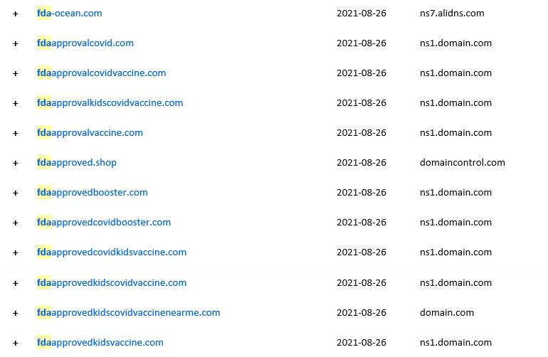
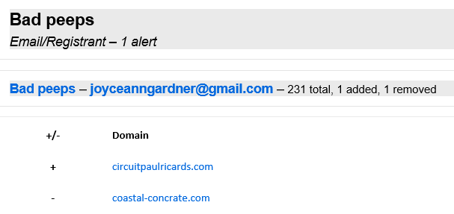
Typo Squatting
Frank Olmstead

Slide 9
Business Email Compromise (BEC)
Frank Olmstead
Business Email Compromise: Hacker impersonates a supplier or compromises supplier email system to inject bad information to redirect financial payments for financial gain
FBI reports 2019 BEC losses of $1.7B, ½ of all reporting!
Targeting
Hacker uses open source web sites to target suppliers and customers
Takeover
Hacker compromises one or more supplier email accounts to get inside normal business communications flow
Monitoring
Hacker inserts ‘bad’ payment info to redirect payment or shipment of goods & material
Attack
Hacker looks for opportunity in email flow (large payments, changes, time sensitive transactions)

Slide 10









Threat Example Anatomy of a Supply Chain Business Email Attack
Supplier Compromised
Attacker compromises supplier email services
Attacker monitors email server to ID relationships
Supplier Challenges
Small scale ($85M revenue, 500 employees) can’t support mature defenses
Lack of funding for cyber tools
Part time (if any) cyber security staff
Creates fake website
Vendor.com ->
vendor-us.com
5
Sends doctored invoice to Customer
FBI estimates 2018 losses from Business Email Attacks at $12B
Notes:
GD-OTS has a contract with TENCATE to deliver Armor Kits for Vehicles.
- TENCATE suffered a compromise of their info systems, allowing the threat actor(s) to obtain knowledge of an upcoming payment.
- Threat actor(s) created three domains (gd-otss.com <not used as far as we can see>, tcae-usa.com and tcead-us.com)
Utilizing tcae-usa.com email to communicate with GD-OTS employees, requested to change SWIFT payment information for ~950k PO.
We’ve seen an increase in the WRT doppelganger sites theoretically could be used as BEC:
GeneralDynamicsGroup.com (killed - Registrant)
GD-OTSS.com (killed - Registrant)
GDBenifits.com
GneralDynamic.com (killed - Registrant)
GenerallDynamics.com (killed - Registrant)
exprofinance.com & exprofinance.info (killed - RCMP)
tcae-usa.com & tcead-us.com (killed - Registrant)
Gdeufl.com – (killed), used to swindle external folks out of $125k, but going after $1mil
FBI reporting indicated the total value of funds redirected as a result of BEC scams have doubled from 2017 to $12B, US Companies have lost an estimated $1.3B
- Ref https://www.zdnet.com/article/fbi-us-companies-lost-1-3-billion-in-2018-due-to-bec-scams/

Slide 11
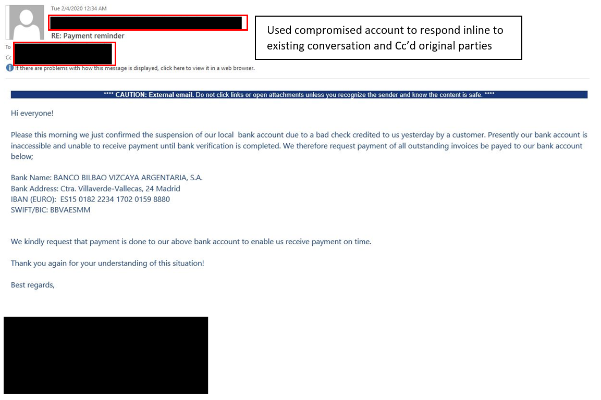
Actual BEC Email Sample
Frank Olmstead
Man in the Mailbox Email Attack
Compelling reason they are asking for change
Inject fraudulent payment info
Look for time pressures to make change fast

Slide 12
Best Practice Do’s and Don’ts
Frank Olmstead
Do:
Engage with AP and Treasury teams on implementing internal controls memo: ‘immediately implement call-back’
Consider mandatory ‘pause’ on all payment / banking changes with delayed second person review / approval
Consider NOT processing changes after noon on Thursday (hard to reverse payment over weekend!)
Flag external emails with a warning banner
Utilize non-email verification (e.g. verbal confirmations, etc.) for banking changes
Don’t:
Delay reporting! First 72 hours are key to recovering $
Trust the contact information given
Think someone else will fix this, everyone is part of solution

